Slide 1



POSITIONING TATA CLIQ FOR THE LLM SEARCH ERA
Generative Engine Optimization

Slide 2
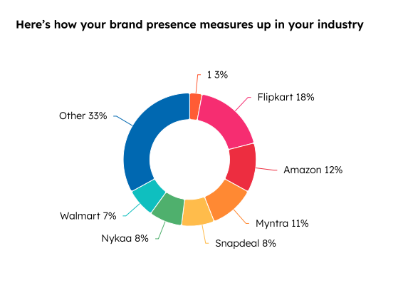
GENERATIVE ENGINE OPTIMIZATION
Get recommended by AI
0%-Tata CliQ’s Chat GPT visibility in e-commerce, highlighting GEO needs
For GEO, user-relevant content is more important than keyword stuffing.
Content quality is increasingly measured by its relevance to user queries
42% of e-commerce sites report declining organic search referrals as AI-generated shopping results gain traction !
Source: Hubspot AI Search Grader

Slide 3
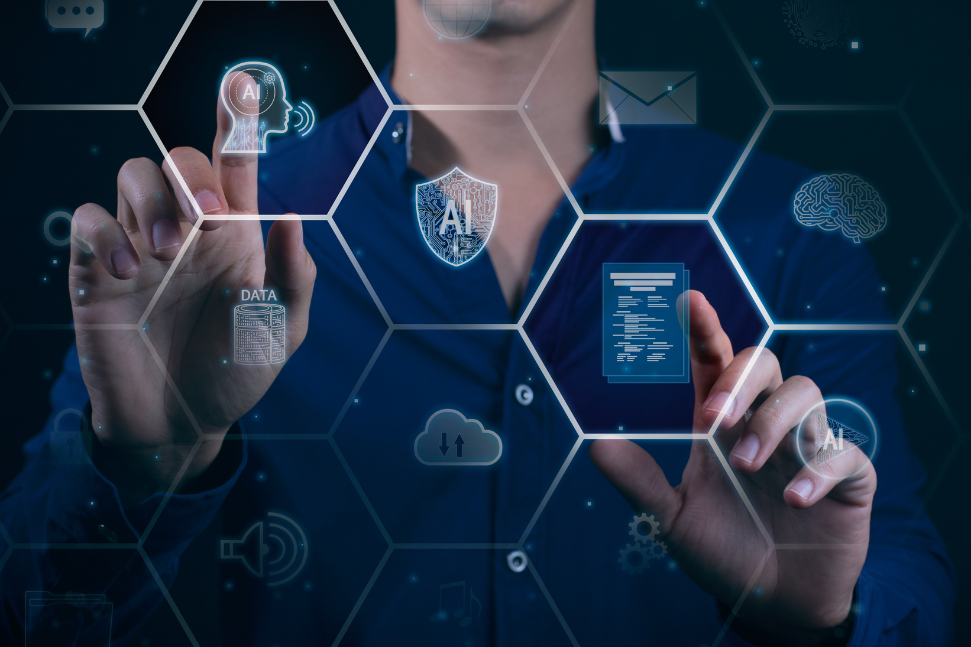
KEY STATS
400 million
The average weekly ChatGPT users worldwide
13.5 %
Largest user share is from India
46 %
Share of queries utilizing the search feature
37.5 million
Searches per day in 2024
45%
Share of users that are millennials
13 billion
Money invested by Microsoft into Open AI
30%
AI visibility through traditional SEO

Slide 4
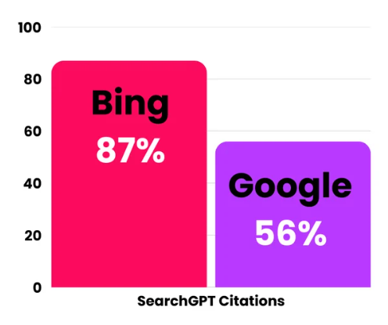
THE OPEN AI & BING CONNECTION
Microsoft’s strategic partnership
87% of Chat GPT citations matched Bing’s top 20 results!
For Google, this number is just 56%
Also, Bing’s search share has doubled to 11% in the last 5 years!
Currently, Tata Cliq is ranking in the 3rd page of Bing Search for Fashion Stores while it is in the 1st page in Google
Source: Seer Interactive

Slide 5
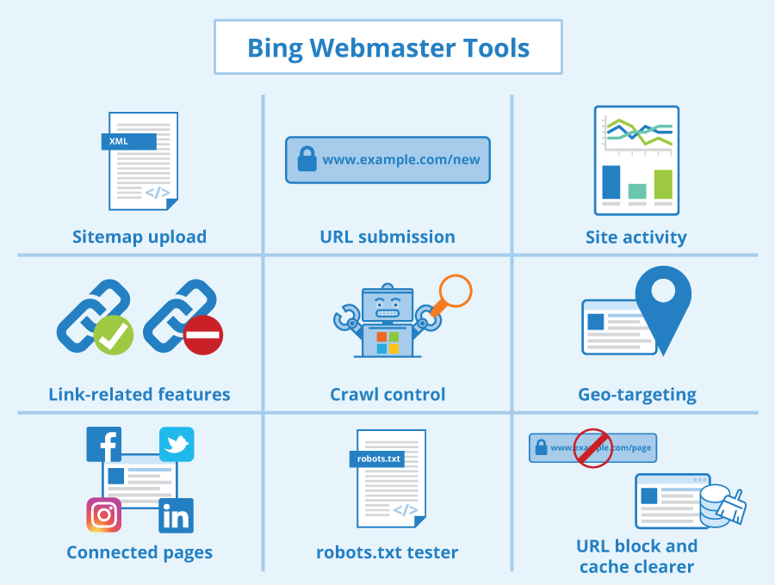
IMPROVING BING GEO/SEO
Bing Webmaster Tools
BWT is the Microsoft equivalent of GSC
According to Microsoft, Businesses using BWT have seen 45% increase in Organic Bing Traffic
Upto 30% improvement in click-through rates via improved SERP positions
Unlike GSC, Bing allows for instant indexing of updated content (Indexnow)

Slide 6

IMPROVING BING SEO
Social Traffic Signals
Google doesn’t consider social traffic for SEO, but Bing does
Bing tracks how often your content is shared, liked, or mentioned on platforms like Facebook, Twitter, and LinkedIn
AI crawlers are trained on public data like those available on Reddit, Twitter, etc
Hence, Twitter presence is essential for AI visibility
Currently, Tata CliQ doesn’t have a verified Twitter Handle

Slide 7
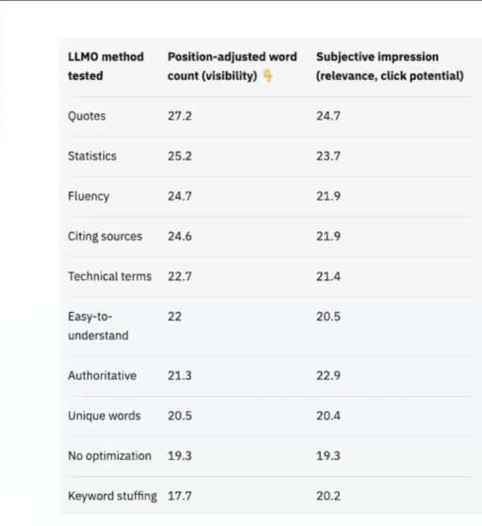
ENHANCING OPEN AI VISIBILITY
Get Cited by Chat GPT
Using quotes, stats, and citations included the chance of getting cited by 24.6% -95% waterproof material
ChatGPT heavily prioritizes content from authoritative sources (41%)-Wikipedia citings
Model prefers content structured in direct QA format
Including Online reviews increased the chance of getting cited by 16%
Research by Ahrefs graded the effectiveness of different strategies for LLM Visibility as shown
Source: Ahrefs

Slide 8
ASK CLIQERS
User-Sourced Q&A Layer
LLMO Method-Fluency, Authority
User questions have natural phrasing that Gen AI engines prefer over Keyword stuffing
Q&A content can increase organic traffic by up to 400% and overall traffic by up to 200% due to authority from user content.
80% of sources featured in Google AI Overviews don’t need to rank in the top 10 if they are well-structured and answer user queries directly.
50.08% of e-commerce sites lack product schema markup, which is critical for AI visibility. Implementing it for Q&A content can give a competitive edge

Slide 9
CLIQ FACTS
Facts That CliQ From Sources That Prove
LLMO Method-Statistics, Source Citation
AI models prefer citing content that appears factual and verifiable
Content with statistics is 40% more likely to rank on the first page of search results, as it matches AI’s preference for structured data
Statistics scored 25.2 in position-adjusted word count—2nd highest among all methods
Numbers often lead to better eligibility for featured snippets or answer boxes, which AI models scrape from
Pages citing data from authoritative sources (e.g McKinsey) rank 25% higher on average

Slide 10
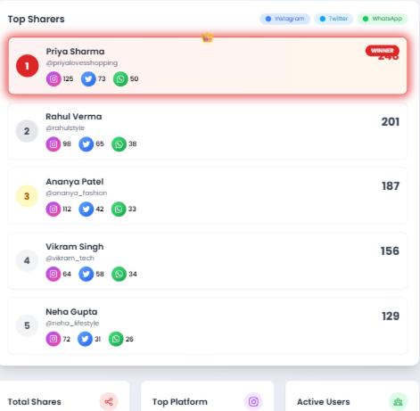
LOYALTY: SLIQ POINTS
Incentivising User Engagement
LLMO Method-Authority, Citing Sources
75% of AI search engine citations come from third-party sources like X posts, reddit posts, medium posts
SliQ Points incentivises users to share products they purchased/liked across social media platforms
X share=20 pts
Whatsapp story share=10 pts
Instagram story share=10 pts
Customers with highest pts are rewarded with coupons/CliQ cash or other rewards

Slide 11
THANK YOU!

